Slide 1

Thrive Behavioral Health
Presents…
“Parents Can Do Virtually Anything”
Managing Distance Learning and Staying Calm
Join this interactive webinar on Monday, August 24, 2020 from 5-6 pm
Zoom Log-In: missadrian1
Presented by: Adrian Stackhouse, LCSW-C

Slide 2

Thrive Behavioral Health
Presents…
“Parents Can Do Virtually Anything”
Managing Distance Learning and Staying Calm
Presented by: Adrian Stackhouse, LCSW-C
August 24, 2020

Slide 3



Agenda
Feelings Check-In
Video – ‘Momschooling’ by EJ Speaks (YouTube)
Well…What’s the worst thing that could happen?
Tips for Virtual Learning
Calgon Take Me Away
Questions & Answers

Slide 4


Slide 5

“How Are You Feeling?”
Notes:
The end of March, all schools in Maryland closed creating a wave of emotions for families. Parents assumed more responsibility of overseeing their child’s learning. Students tried to make sense out of this as their diningroom quickly became the classroom. The kitchen became a 24 hour cafeteria. The struggle became real! “How are your feeling” about the start of another school year?

Slide 6
YouTube Video
EJ Speaks
“Momschooling Be Like”
https://www.kapwing.com/videos/5f43a430c0339d001589c0b0
Notes:
This video has been modified. However, many parents can relate to these challenges. EJ has given humor to the experience of many parents and guardians.

Slide 7
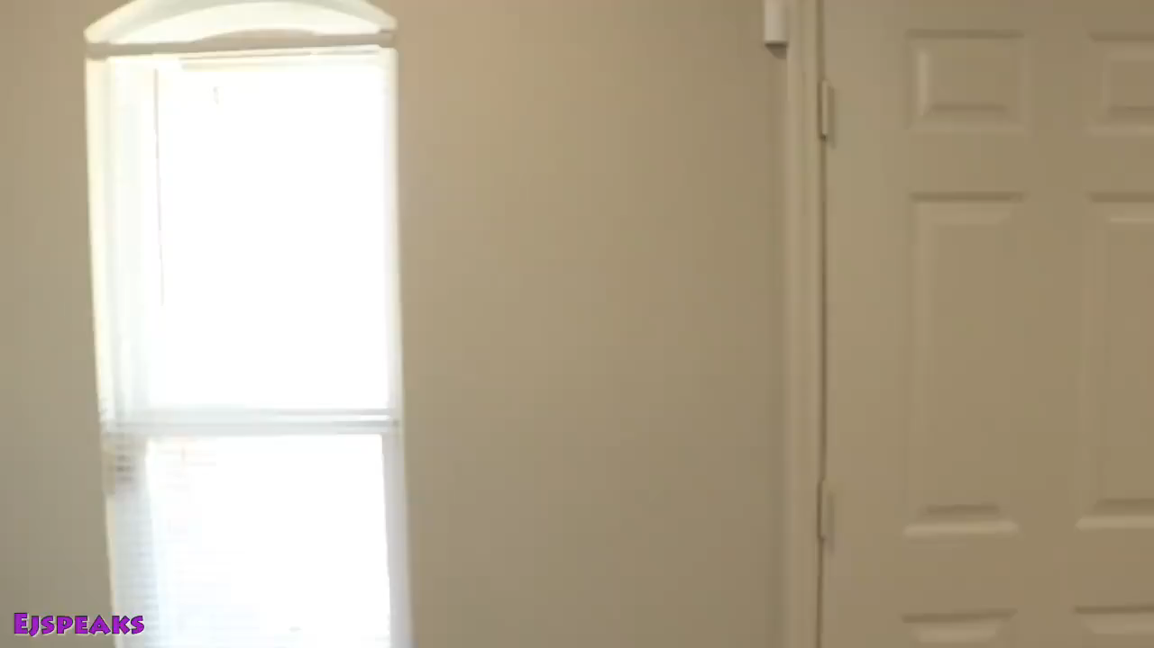

Slide 8
Chat Discussion:
How many school aged children do you have?
What grades?
Do you have a child with special needs?
What is your greatest concern with virtual learning?
Notes:
Please feel free to answer 1 or more of these questions in the chat box.

Slide 9

Well…What’s the worst thing that could happen?
No electronic device
The internet isn’t working
Unable to log-in for class (can’t locate the web address)
Audio/video challenges
Distractions/difficult to motivate students for learning
Limited computer experience
Delayed feedback between teachers and students
Potential challenges moving between screens and submitting assignments
Notes:
Contact your child’s school to inquire about the distribution dates for electronic devices and support with wi-fi connection.

Slide 10
Troubleshooting:
Be mindful of the learning environment
Contact the school/teacher ASAP
Log out and log back into the website
Call your internet provider
STAY CALM
Notes:
When speaking to the school staff and/or teacher, ask if the instruction will be recorded as this will help if a problem is experienced.

Slide 11




Is “Fun”damental
Notes:
Learning is essential and “Parents can do virtually anything.”

Slide 12
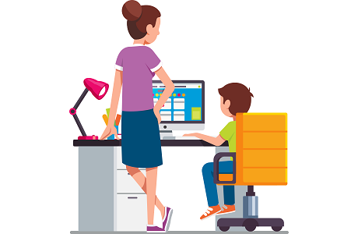
Tips For Virtual Learning
Notes:
Let’s address a few tips for virtual learning…

Slide 13

“It’s the final countdown…”
1-2 weeks before the beginning of school:
Reinstate a bedtime. Have your child go to bed earlier.
Reintroduce morning wake-ups to gradually start preparing for the day. Set an alarm!
Notes:
The Coronacation is coming to an end, talk with your child about physically preparing for the beginning of a new school year.

Slide 14

Purchase school supplies
Notes:
Schools have posted the 2020-2021 school supply list to their website.

Slide 15
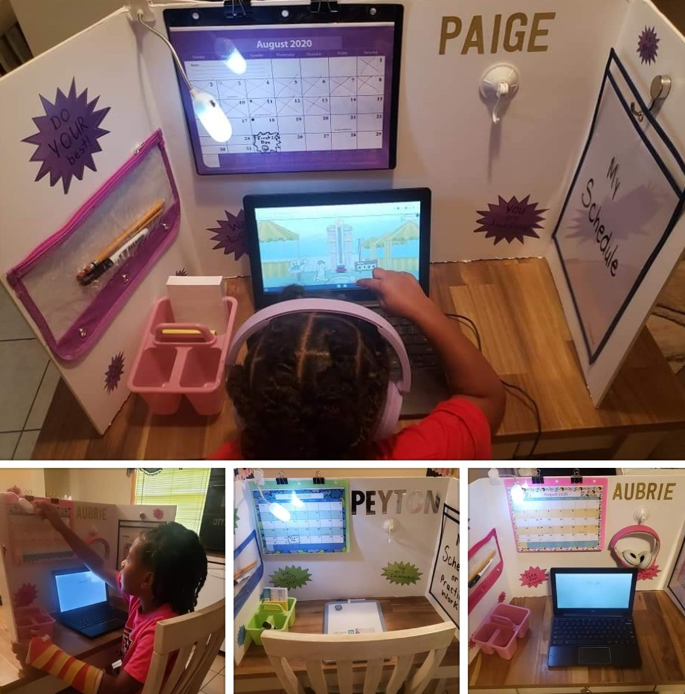
Create a workspace for learning
Designate an area free from distractions
Notes:
A tri-fold board (purchased at the Dollar Tree) provides privacy while enhancing your child’s organizational strengths. (Talk about items in the pic)

Slide 16
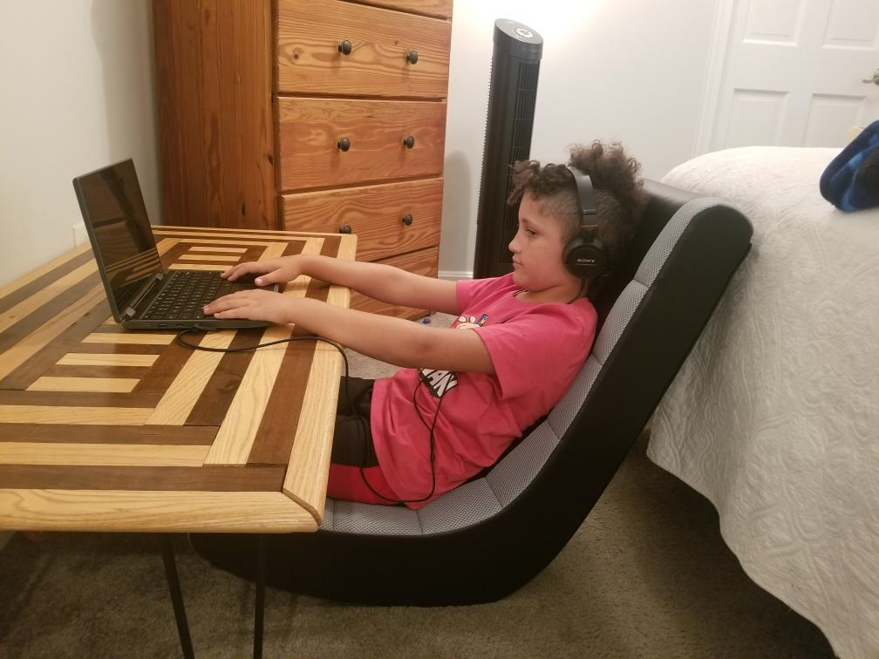
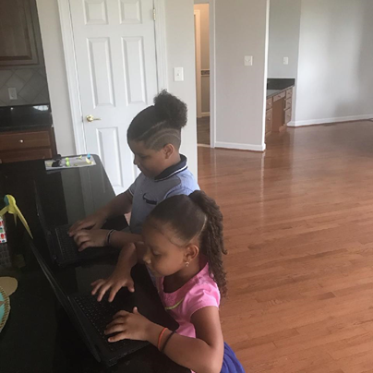

Slide 17

Notes:
While engaging in virtual learning – “less is best”. Whenever possible , try to limit the amount of potential distractions.

Slide 18
Students have said:
“I need a quiet place to work.”
“I need to be comfortable.”
“I don’t like when parents are giving their kids the answers.”
“I would love to be in school but I’m still learning.”
“My grades matter.”
“I need to be able to ask my teacher questions.”
“I refuse to be afraid because I have people who support me.”
Notes:
Here are some comments that have been shared with me about virtual learning…

Slide 19

Notes:
Parents are doing their best, so “Don’t Compare Yourself to Others”

Slide 20

Notes:
Now it’s time to talk about what’s expected for your scholar…

Slide 21
Be on time for class
R-E-S-P-E-C-T (show consideration to classmates)
Keep the mic turned off until you are asked to speak
Turn off the audio if your child is anxious
Use headphones to limit distractions

Slide 22
If your child is “antsy” create a square to stand/sit that’s close to the computer
Monitor the screen – Is your daughter/son staying focused?
Ask the teacher questions
Create a “to-do” list as a reminder of when assignments are due
Charge the device nightly

Slide 23

Digital quarantine – 6 feet, please. Children should avoid texting and social media during school hours.

Slide 24

Parents should:
Check-in at the beginning of the school day
Check-in during the middle of the school day
Check-in at the end of the school day
Notes:
This can be…how are you feeling this morning? How were your morning classes? How were the afternoon classes? What’s something that you learning?

Slide 25
Beronica’s Weekday E-Learning
Schedule (Example)
7:00 am – 8:15 am: Wake up, prepare for the day (eat a
healthy breakfast), have supplies at hand, check-in
8:30 am – 8:45 am: Sign onto the school’s e-learning site
8:50 am – 9:20 am: Academics
9:50 am – 10:20 am: Break
10:25 am – 10:55 am: Academics
11:00 am – 12:00 pm: Lunch, check-in
12:10 pm – 12:40 pm: Academics
12:50 pm – 1:20 pm : Break and DEAR Time (reading)
1:30 pm – 4:00 pm: Check-in, socialize with friends
Notes:
Post the schedule where it can be seen: trifold board, wall, door,…

Slide 26

Maintain organization to avoid procrastination
Write teachers office hours at the top of the calendar
List assignments and due dates
Notes:
Parents and older students should have a calendar near the school schedule.

Slide 27
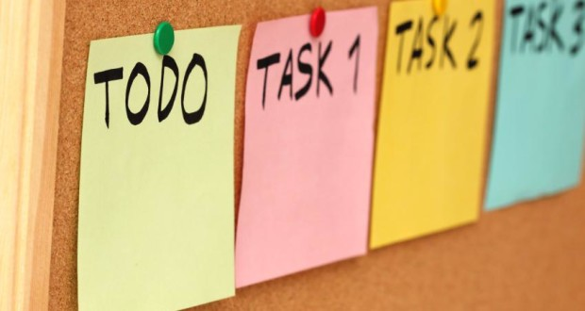

Break tasks into
smaller chunks
Use a timer for breaks

Slide 28
Stay Positive and give yourself and your child credit…
“Nice work”
“Keep up the good work”
“You/we did it”
“You’re very responsible”
“Way to go”
“That’s a great idea”

Slide 29

Notes:
You Made It Through The School Day…”What about me?”

Slide 30
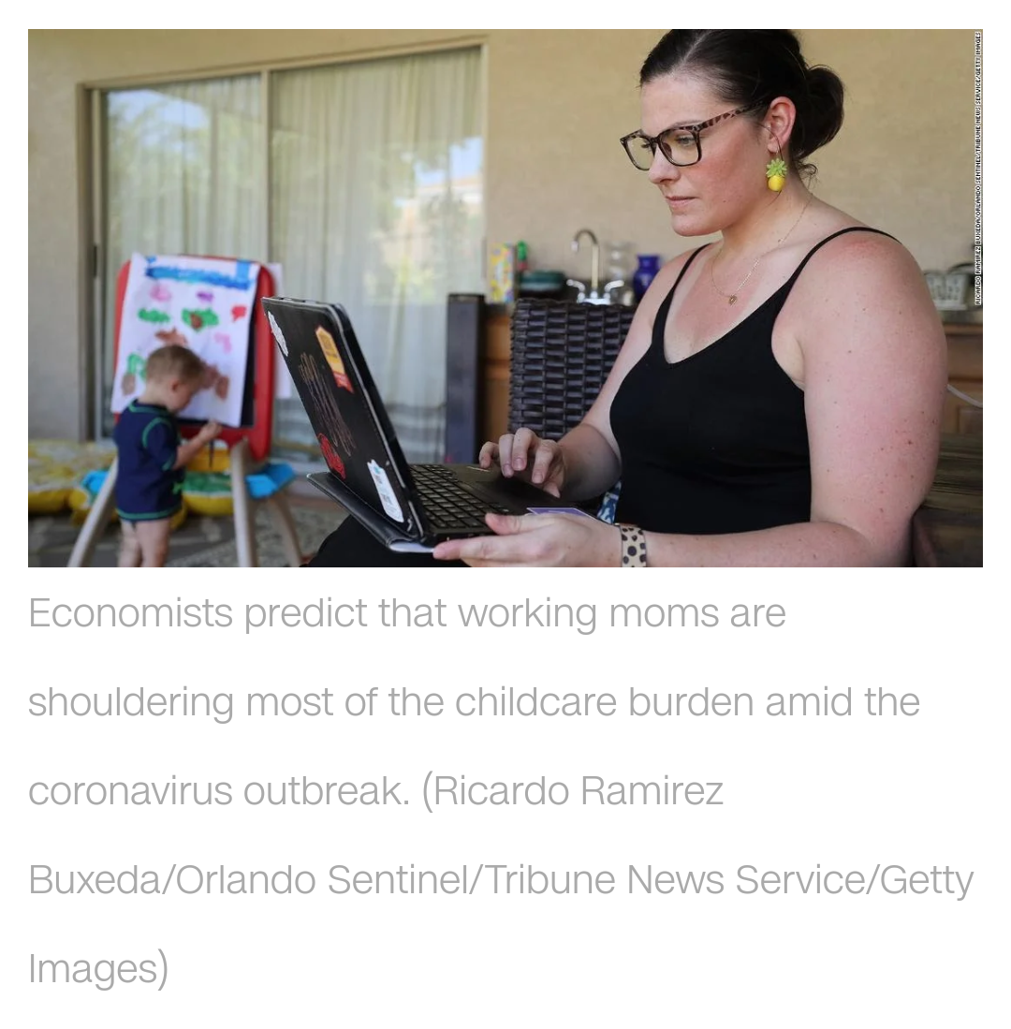
Notes:
This can feel overwhelming for so many parents who are doing their best to meet their child’s needs as well as their own.

Slide 31
What Is Stress?
Stress is your body’s physical and mental
response to anything you perceive as
overwhelming. You feel stress when you
face life’s demands, pleasant or
unpleasant, and feel that you lack
resources to meet them. When stressed,
your body creates extra energy to protect
itself.

Slide 32
How Do You Respond to Stress?
Physical
Headaches
Fatigue
Insomnia
Weight change
Pounding heart
Restlessness
Neck and shoulder ache
Mental
Forgetfulness
Poor concentration
Boredom
Confusion
Low productivity
Negative attitude
No new ideas

Slide 33
How Do You Respond to Stress?
Emotional
Social
Anxiety
Irritability
Depression
Bad temper
Crying spells
Confusion
Isolation
Lashing out
Resentment
Lower sex drive
Fewer contacts
Nagging

Slide 34

Share your comments in the chat box

Slide 35
Coping Strategies:
Listen to your needs
Control what you can
Structure your day
List your options
Don’t give up
Notes:
I have listed a few coping strategies…

Slide 36
Get enough rest
Eat well-balanced meals
Make time for yourself
Exercise
Cook or bake
Pray

Slide 37
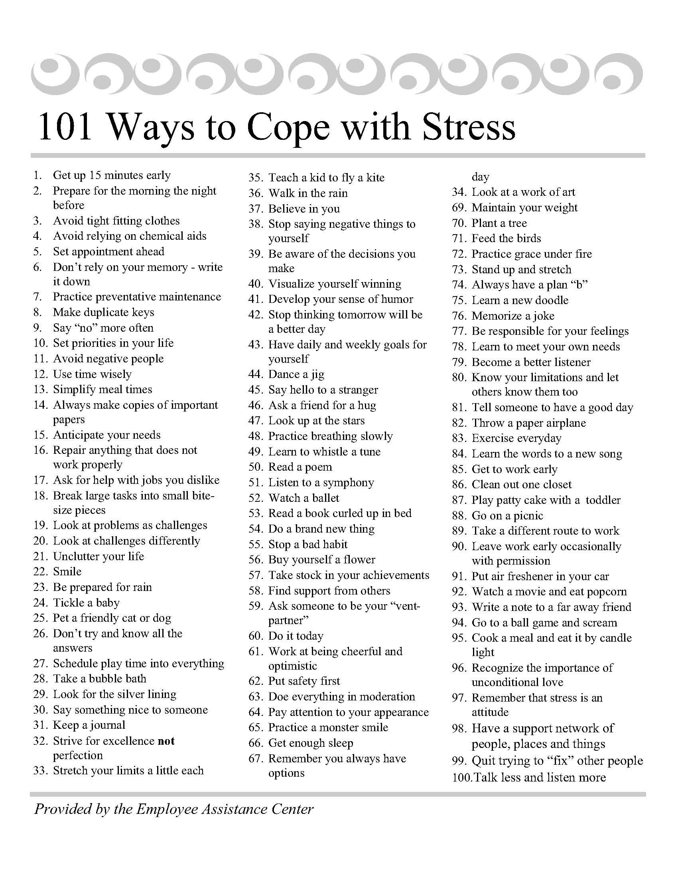

Slide 38

“Help is a phone call away”
First Call for Help: 410-685-0525
Baltimore City Crisis Response:
410-931-2214
Baltimore County Crisis Response:
410-931-2214
Notes:
Please remember that “Help is a phone call away”

Slide 39
The Family Tree: 1-800-243-7337
REACH Hotline (Substance Use Information):
410-887-3224
Grassroots Crisis Line: 410-531-6677
Maryland Youth Crisis: 1-800-422-0009

Slide 40

410-780-4320

Slide 41


Slide 42
Remember:
“Parents Can Do Virtually Anything”

